Slide 1

CELLULA TECHNOLOGIES
HOTEL CANCELLATIONS INSIGHTS
TASK 1 : Simple insights driven from Our Booking Data
By : Noureldeen Hossam

Slide 2
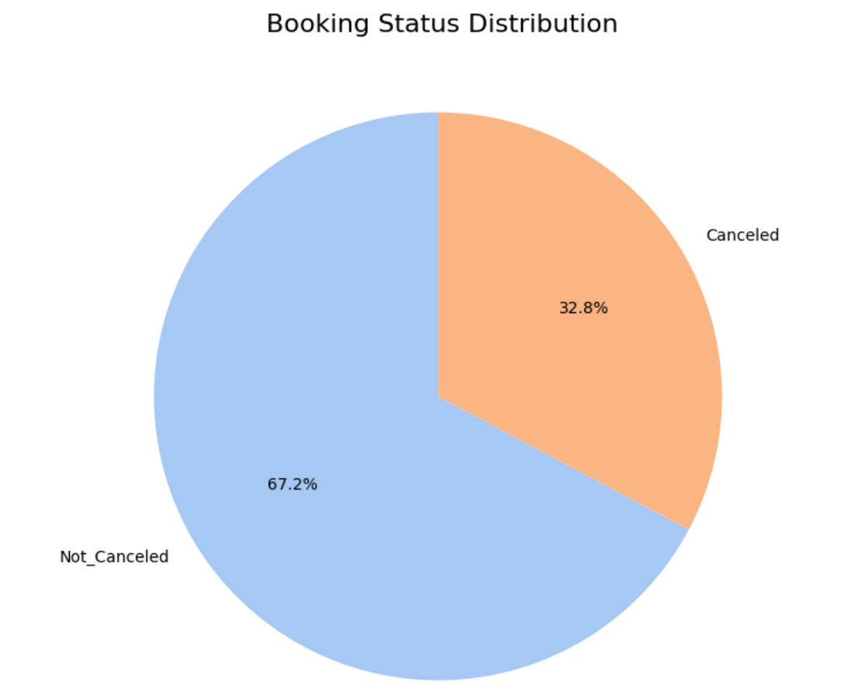
Hotel Booking Status Distribution
Plot Explanation: This pie chart shows that our bookings are split into two main groups: "Not_Canceled" (confirmed bookings) and "Canceled".
Key Insight: A significant portion, 32.8%, of all hotel bookings are canceled, which clearly highlights the challenge we face.

Slide 3
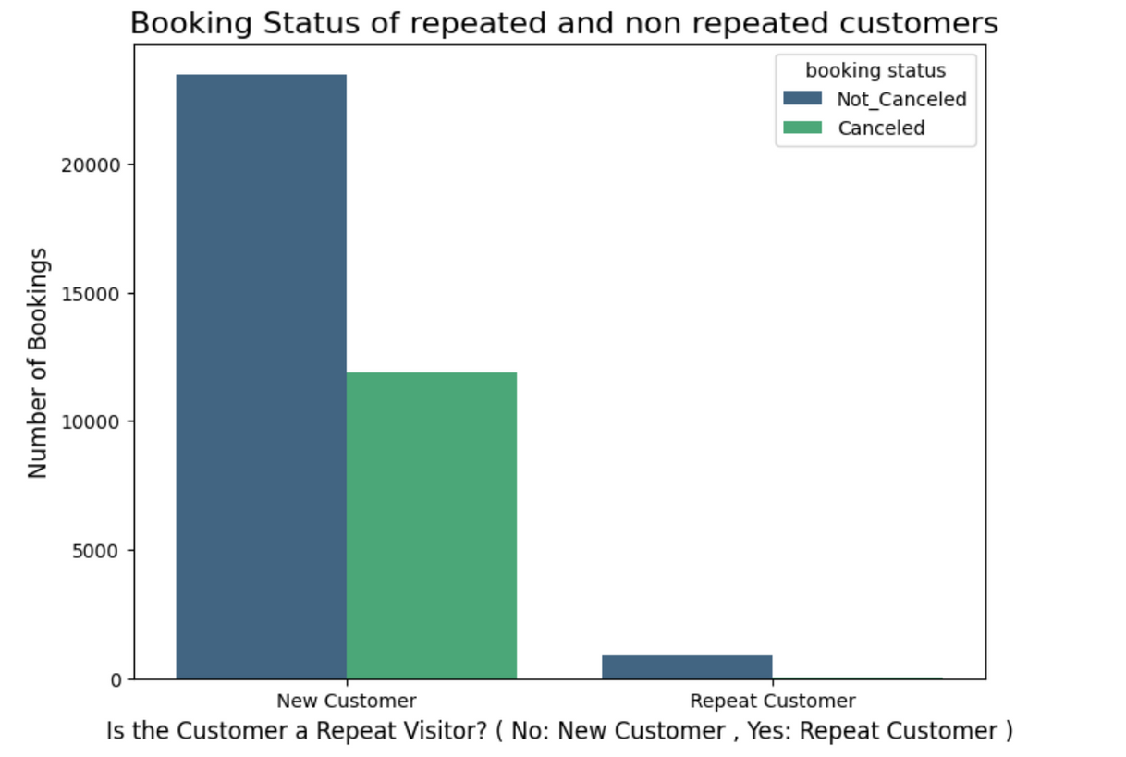
Booking Status of New vs. Repeat Customers
Plot Explanation: This bar chart compares the number of confirmed ("Not_Canceled") and canceled bookings for new customers versus repeat customers.
Key Insight: We have significantly more new customers than repeat customers. While new customers make up most bookings, repeat customers cancel less often, highlighting their loyalty.

Slide 4
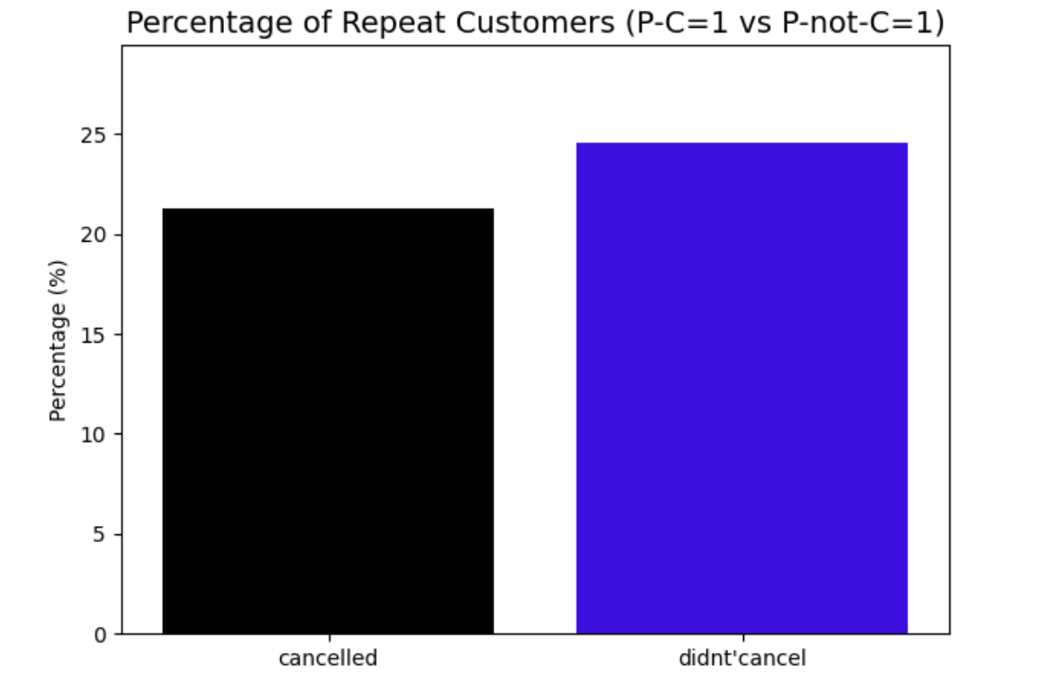
Repeat Customer Behavior
Plot Explanation: This chart shows, among our repeat customers, the percentage who previously canceled a booking (cancelled) versus those who didn't (didn't cancel).
Key Insight: A higher percentage (24.52%) of repeat customers previously did not cancel, compared to 21.29% who previously canceled. This suggests repeat customers with a history of not canceling are slightly more common.

Slide 5
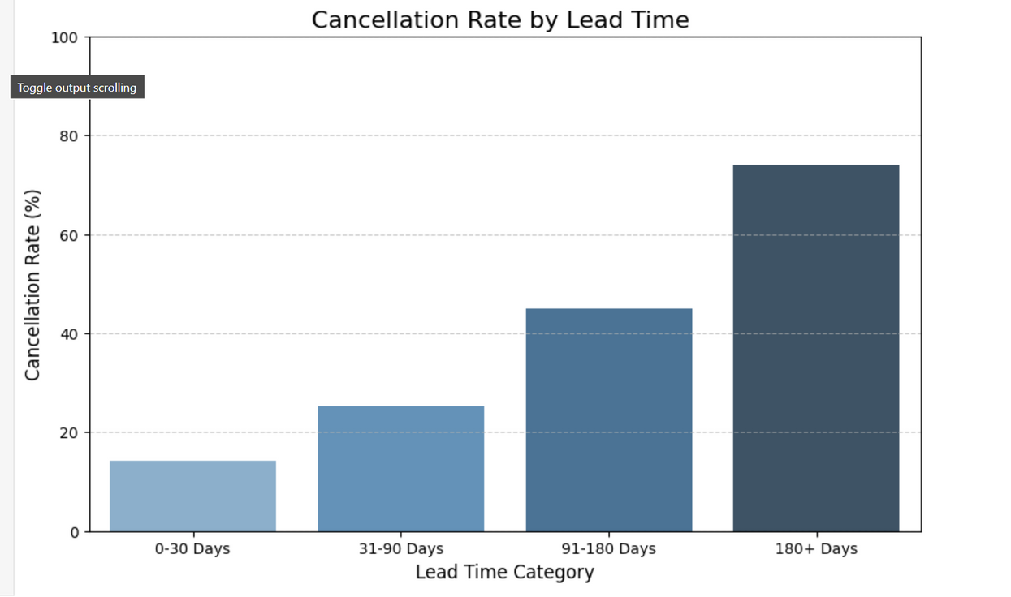
Cancellation Rate by Booking Lead Time
Plot Explanation: This chart shows how the percentage of cancellations increases significantly as the time between booking and arrival (lead time) gets longer.
Key Insight: Bookings made far in advance (180+ days) have a very high cancellation rate (73.88%), indicating less firm intentions compared to short-notice bookings.

Slide 6
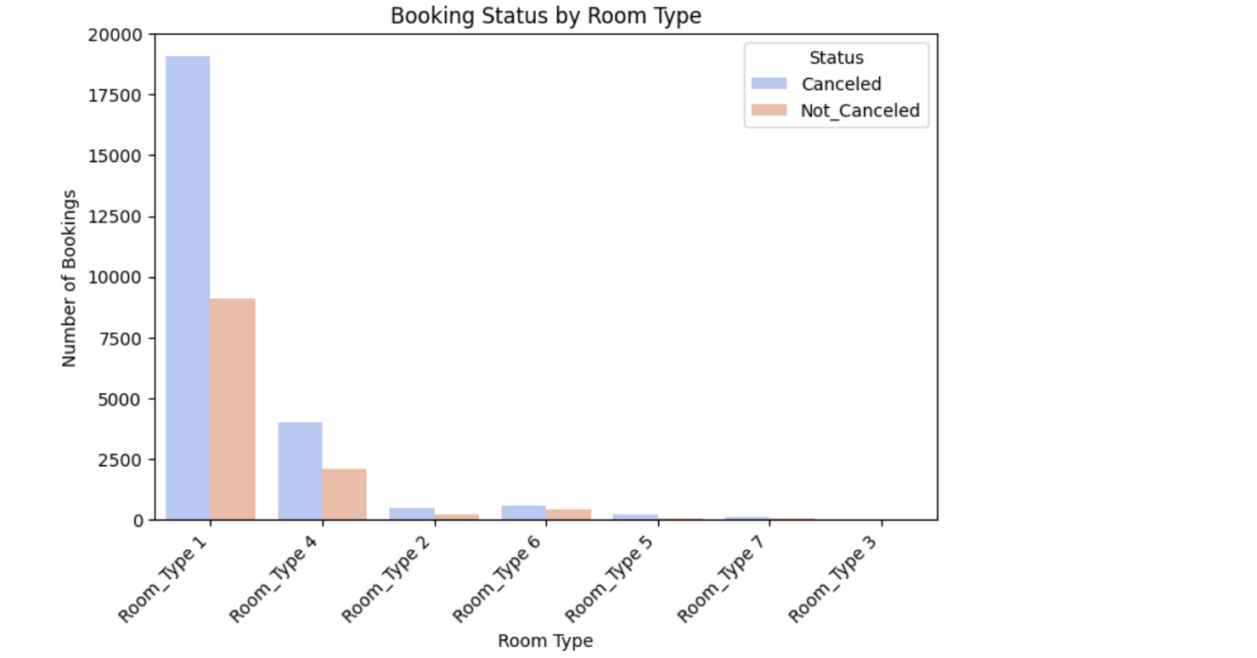
Booking Status by Room Type
Plot Explanation: This chart shows the number of confirmed ("Not_Canceled") and canceled bookings for each different room type available.
Key Insight: "Room_Type 1" has the highest number of bookings overall, but also a significant number of cancellations. You can observe the cancellation patterns across various room types.

Slide 7
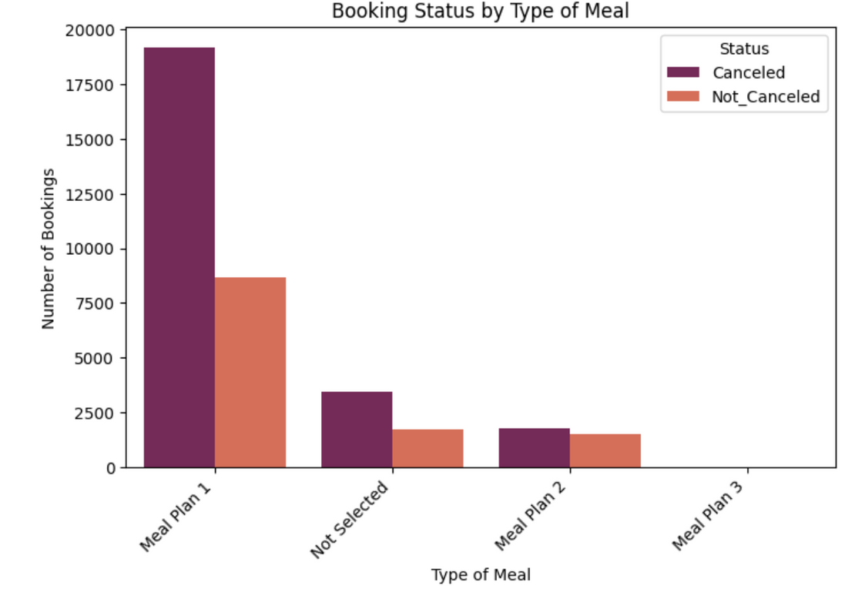
Booking Status by Type of Meal
Plot Explanation: This chart shows the number of confirmed ("Not_Canceled") and canceled bookings for each different type of meal plan offered.
Key Insight: "Meal Plan 1" has the highest volume of bookings, but also shows a significantly higher number of cancellations compared to its confirmed bookings.

Slide 8
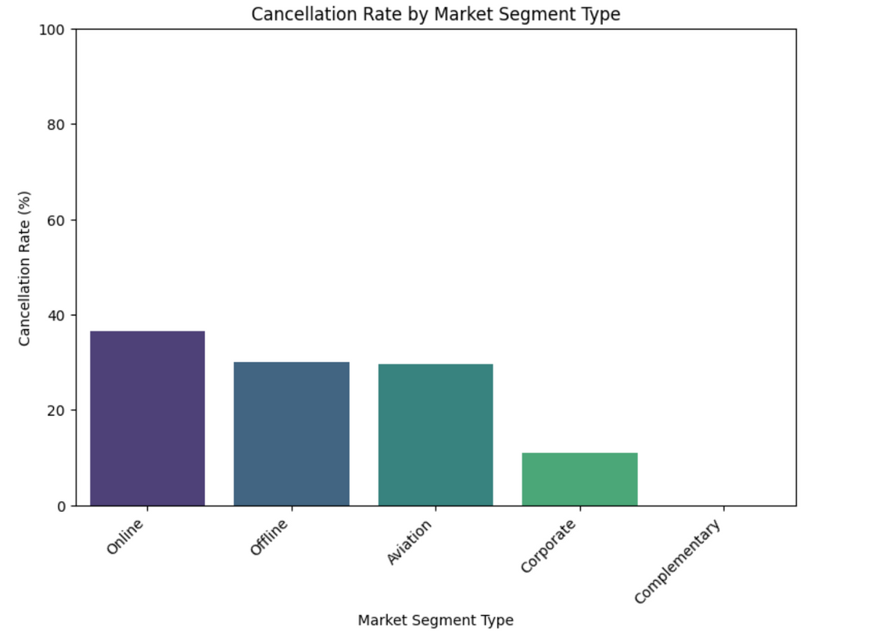
Cancellation Rate by Market Segment
Plot Explanation: This chart shows the cancellation percentage for bookings coming from different marketing channels (Online, Offline, Aviation, Corporate, Complementary).
Key Insight: The "Online" segment has the highest cancellation rate (36.51%), while "Corporate" and "Complementary" segments show much lower rates (10.91% and 0.00% respectively), indicating different reliability across channels.

Slide 9
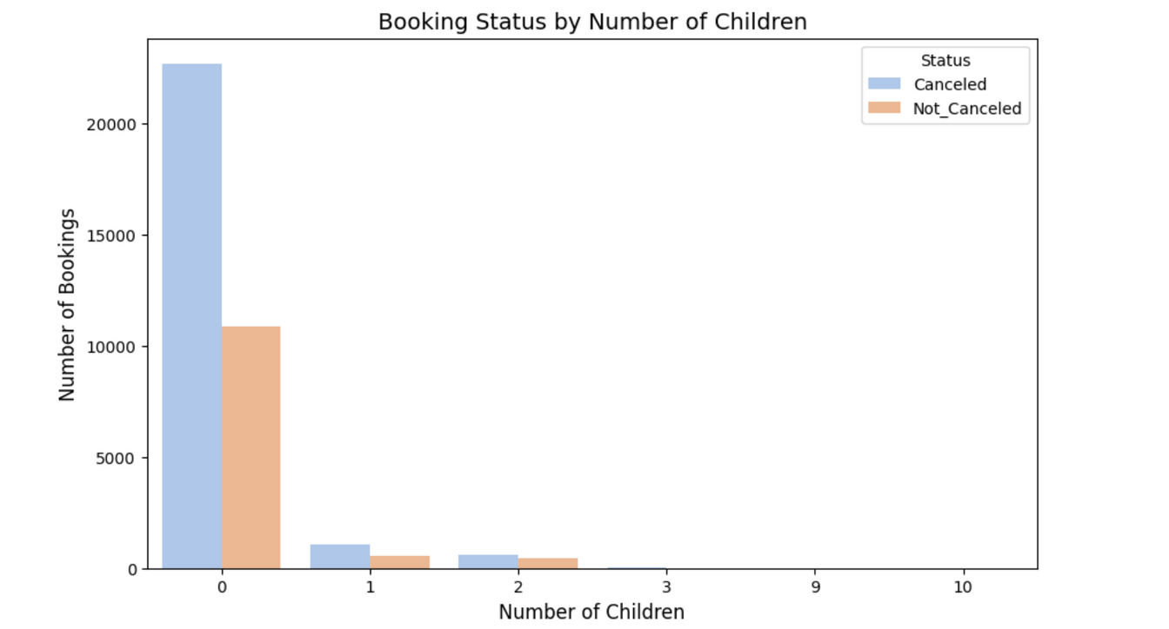
Booking Status by Number of Children
Plot Explanation: This chart shows the number of confirmed ("Not_Canceled") and canceled bookings based on the number of children included in the reservation.
Key Insight: The vast majority of bookings, both confirmed and canceled, are for stays with no children. Bookings with children appear to have a lower cancellation rate relative to their total volume compared to bookings without children.

Slide 10
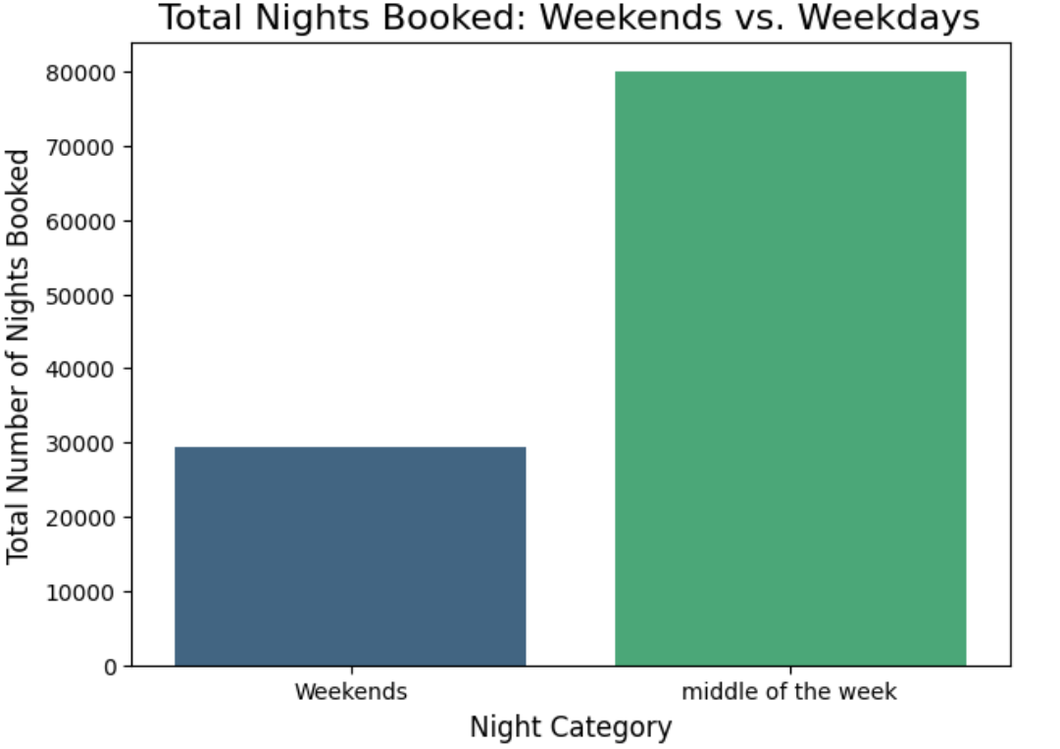
Total Nights Booked: Weekends vs. Weekdays
Plot Explanation: This bar chart shows the total number of nights booked, comparing weekend nights to weekday nights.
Key Insight: Our hotel sees significantly more bookings for weekday nights (79,994 nights) compared to weekend nights (29,416 nights). This highlights a strong weekday demand.

Slide 11
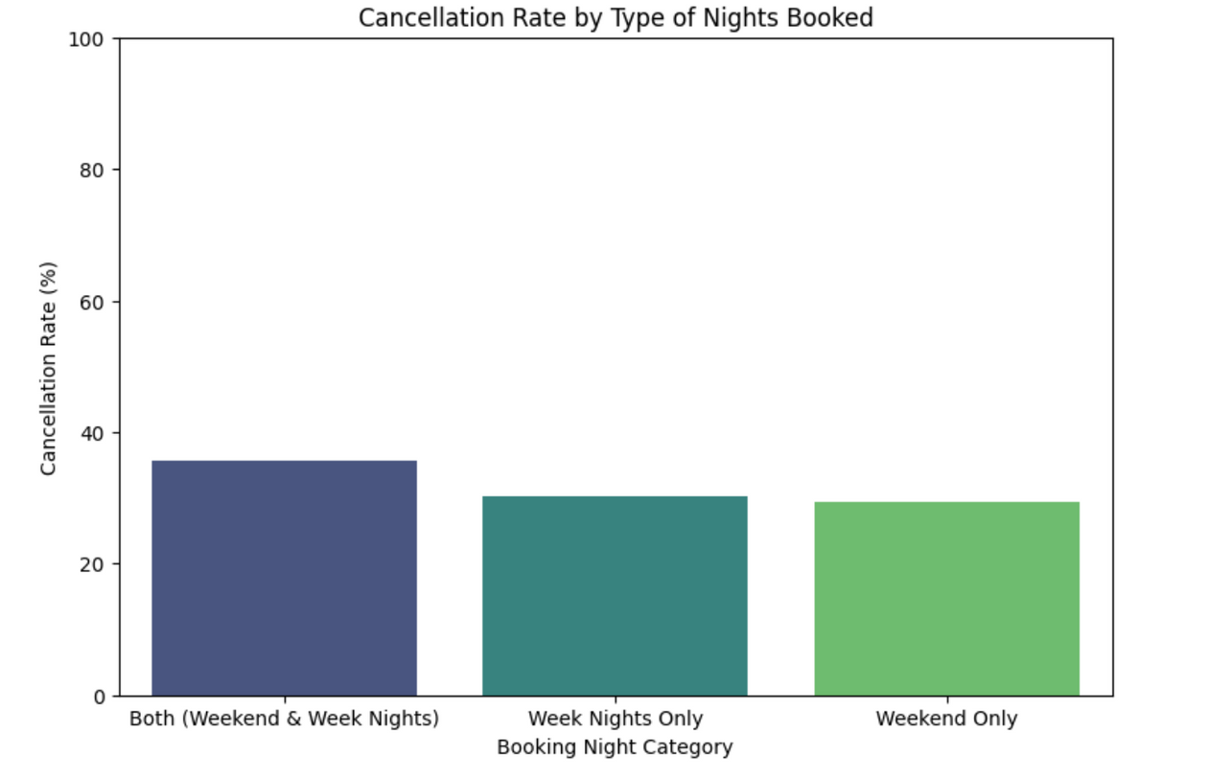
Cancellation Rate by Type of Nights Booked
Plot Explanation: his chart shows the cancellation percentage for bookings categorized by "Weekend Only", "Week Nights Only", "Both (Weekend & Week Nights)"
Key Insight: Bookings that include "Both (Weekend & Week Nights)" have the highest cancellation rate (35.62%). This indicates these mixed-period stays are less firm.

